Slide 1
What Is Frequent Pattern Analysis?
Frequent pattern: a pattern (a set of items, subsequences, substructures, etc.) that occurs frequently in a data set
Motivation: Finding inherent regularities in data
What products were often purchased together?— Beer and diapers?!
What are the subsequent purchases after buying a PC?
What kinds of DNA are sensitive to this new drug?
Applications
Market Basket data analysis, cross-marketing, catalog design, sale campaign analysis, Web log (click stream) analysis, and DNA sequence analysis.

Slide 2
Frequent Itemsets
A set of items is referred to as an itemset
E.g., X = {milk, bread, cereal} is an itemset.
An itemset that contains k items is a k-itemset.
The set {computer, antivirus software} is a 2-itemset.

Slide 3
Association Rule
Association rule can be thought of as an IF -> THEN relationship.
Consider the rule A -> B.
If a customer buys a product A, then the chances of item B too being bought by the customer under the same Transaction ID is found out.
A co-occurance pattern comes into picture.

Slide 4
Association Rule
A→B
IF contains an item or an item group that are typically found in the itemset.
THEN contains items that comes along with an antecedent group.
{Bread, Butter}=> {Egg}
IF
THEN
Antecedent
Consequent

Slide 5
Association Rules
Association Measures
Confidence
Lift
Support

Slide 6
Association Rule Mining

Slide 7
Support and Confidence
Example: An example is mined from the (some store) AllElectronics transactional database.
buys (X, “Computers”) ➔ buys (X, “software”) [Support = 1%, confidence = 50% ]
X represents customer
Support = 1%, means that 1% of all the transactions under analysis showed that computer and software were purchased together.
confidence = 50% , if a customer buys a computer there is a 50% chance that he/she will buy software as well.

Slide 8
Frequent Itemsets
Find all the rules X → Y with minimum support and confidence
support, s, probability that a transaction contains X ∪ Y
confidence, c, conditional probability that a transaction having X also contains Y
support(X =>Y) = P(X ∪ Y)
confidence(X =>Y) = P(YǀX)
Notes:
Support(X ⇒ Y) = P(X ∪ Y)
Support of a rule X⇒Y (read as "X implies Y") is the probability that both itemsets X and Y occur together in the dataset.
In simpler terms, support is a measure of how frequently the items in the rule appear together in the dataset.
confidence(X =>Y) = P(YǀX)
"Confidence of X implies Y is the conditional probability of Y given X.“ This tells you how often Y appears in transactions that already contain X.
An association rule in the context of data mining is a rule that implies a certain relationship between items in a dataset. It takes the form:𝑋→𝑌 where:X and Y are subsets of a larger set of items 𝐼I.𝑋∩𝑌=∅, meaning X and Y do not share any common items (they are disjoint sets).In simpler terms, an association rule indicates that when the items in X appear together in a dataset, it is likely that the items in Y will also appear. For example, in a retail context, if X represents the set of items {bread, milk}, and Y represents {butter}, the rule {𝑏𝑟𝑒𝑎𝑑,𝑚𝑖𝑙𝑘}→{𝑏𝑢𝑡𝑡𝑒𝑟} suggests that customers who buy bread and milk are also likely to buy butter.This type of analysis is commonly used in market basket analysis, where retailers are interested in understanding the relationships between different products purchased together. It helps in making decisions about product placements, promotions, and inventory management.

Slide 9
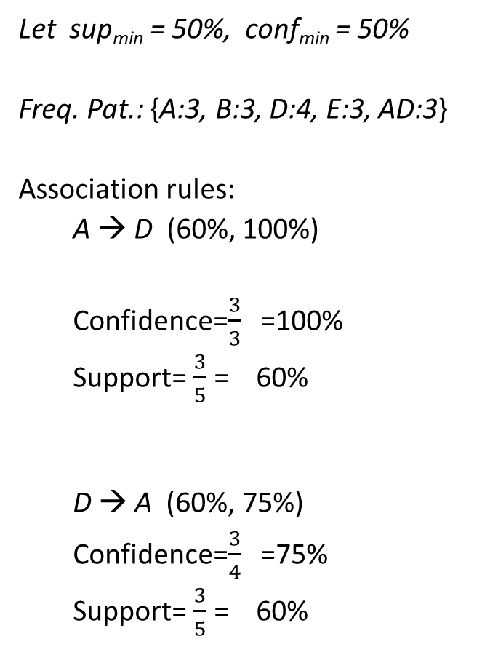
Transaction-id | Items bought
10 | A, B, D
20 | A, C, D
30 | A, D, E
40 | B, E, F
50 | B, C, D, E, F
Let sup_{min} = 50%, conf_{min} = 50%
Freq. Pat.: {A:3, B:3, D:4, E:3, AD:3}
Association rules:
A → D (60%, 100%)
Confidence=$\frac{3}{3}$ =100%
Support= $\frac{3}{5}$ = 60%
D → A (60%, 75%)
Confidence=$\frac{3}{4}$ =75%
Support= $\frac{3}{5}$ = 60%
Customer
buys both
Customer
buys diaper
Customer
buys beer

Slide 10
Association rule mining
Find all frequent itemsets: By definition, each of these itemsets will occur at least frequently as a predetermined minimum support count, min_sup.
Generate strong association rules from the frequent itemsets: These rules must satisfy minimum support and minimum confidence.

Slide 11
Support and Confidence
If the support of an itemset I satisfies a pre-specified minimum support, then I is a frequent itemset.
The set of frequent k-itemsets is commonly denoted by L_{k}
Rules that satisfy both a minimum support threshold (min_sup) and a minimum confidence threshold (min_conf) are called strong.

Slide 12
Closed Frequent Itemset and Maximal Frequent Itemset
A long itemset will contain a combinatorial number of shorter, frequent sub-itemsets.
A frequent itemset of length 100, such as {a1, a2, : : : , a100}, contains 100 frequent 1-itemsets: a1, a2, : : : , a100, frequent 2-itemsets: (a1, a2), (a1, a3), : : : , (a99, a100), and so on.
Itemset of length k, then 2^{k}-1 combinations are possible.
i.e; Too huge a number of itemsets for any computer to compute or store.
Solution: closed frequent itemset and maximal frequent itemset

Slide 13
Closed Frequent Itemset
An itemset X is closed frequent itemset if X is frequent and there exists no super-itemset Y כ X, with the same support as X
An itemset X is considered a closed frequent itemset if:
X is frequent: The itemset X appears frequently in the dataset (i.e., its support meets or exceeds a minimum threshold).
No super-itemset Y with the same support: There does not exist any super-itemset Y (where X⊆Y) that has the same support as X.
Implication: This means that X is a closed frequent itemset if it is frequent and there is no larger itemset that includes X and has the same frequency.
Closed frequent itemsets help in reducing the number of itemsets we need to consider by eliminating redundant itemsets that do not provide any additional information.

Slide 14
Maximal Frequent Itemset
An itemset X is a max-itemset if X is frequent and there exists no frequent super-itemset Y כ X
An itemset X is considered a max-itemset if:
X is frequent: The itemset X appears frequently in the dataset (i.e., its support meets or exceeds a minimum threshold).
No frequent super-itemset Y: There does not exist any super-itemset Y (where X⊆Y) that is also frequent.
Implication: This means that X is a max-itemset if it is frequent and there are no larger itemsets that include X and are also frequent.
Max-itemsets represent the largest sets of items that are frequent, and they help in understanding the boundaries of frequent itemsets in the dataset.

Slide 15
Exercise. A transactional DB = {(a₁, …, a₁₀₀); ( a₁, …, a₅₀)}
Minimum support count threshold min_sup = 1.
What is the set of closed itemset?
<a₁, …, a₁₀₀>: 1
< a₁, …, a₅₀>: 2
What is the set of max-itemset?
<a₁, …, a₁₀₀>: 1
Closed frequent itemsets contains complete information regarding the frequent itemsets
<a₂,a₄₅>: 2 since it is sub itemset of < a₁, …, a₅₀>: 2
<a₈,a₅₅>: 1 since it is sub itemset of < a₁, …, a₁₀₀>: 1
From maximum itemset we can only assert that both itemsets <a₂,a₄₅> and <a₈,a₅₅> are frequent but we cannot assert their actual support counts
Notes:
We find two closed frequent itemsets and their support counts, that is, C = {a1, a2, …. , a100} : 1; {a1, a2, … , a50} : 2.
There is one maximal frequent itemset:M= {a1, a2, …. , a100} : 1; (We cannot include {a1, a2, … , a50} as a maximal frequent itemset because it has a frequent super-set, {a1, a2, …. , a100}
Smaller number of frequent itemsets than 2¹⁰⁰-1 combinations.
The set of closed frequent itemsets contains complete information regarding the frequent itemsets.

Slide 16
Efficient and Scalable Frequent Itemset Mining Methods- Apriori Algorithm
The Apriori algorithm in data mining can help data analysts understand the underlying patterns in their data and help businesses handle their customers better.
The Apriori algorithm is perfect for performing tasks such as market basket analysis.

Slide 17
Efficient and Scalable Frequent Itemset Mining Methods- Apriori Algorithm
Algorithm uses prior knowledge of frequent itemset properties
Apriori property: If an itemset is frequent, then all of its subsets must also be frequent.
Method:
Initially, scan DB once to get frequent 1-itemset
Generate length (k+1) candidate itemsets from length k frequent itemsets
Test the candidates against DB and collecting those items that satisfy minimum support
Terminate when no frequent or candidate set can be generated

Slide 18
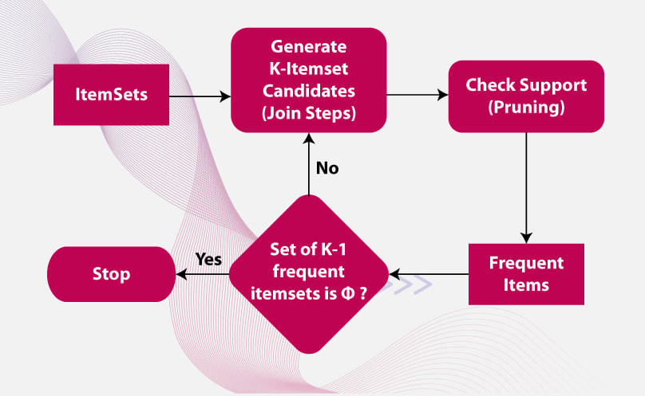
Apriori Algorithm

Slide 19
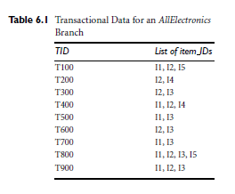
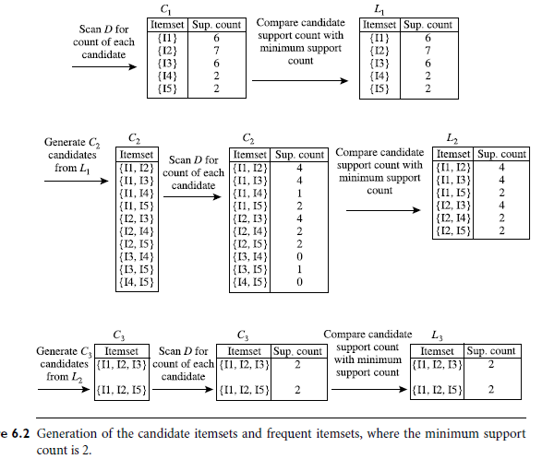

Slide 20
The Apriori Algorithm
Pseudo-code:
C_{k}: Candidate itemset of size k
L_{k} : frequent itemset of size k
L₁ = {frequent items};
for (k = 1; L_{k} !=∅; k++) do begin
C_{k+1} = candidates generated from L_{k};
for each transaction t in database do
increment the count of all candidates in C_{k+1} that are contained in t
L_{k+1} = candidates in C_{k+1} with min_support
end
Return L;

Slide 21
Important Details of Apriori
How to generate candidates?
Step 1: Joining
Step 2: Pruning
How to count supports of candidates?
Example of Candidate-generation
L₃={abc, abd, acd, ace, bcd}
Self-joining: L₃*L₃ ={abc, abd, acd, ace, bcd} *{abc, abd, acd, ace, bcd}
={abcd,acde}
Pruning:
acde is removed because ade is not in L₃
C₄={abcd}

Slide 22
How to Generate Candidates?
Suppose the items in L_{k-1} are listed in an order
Step 1: self-joining L_{k-1}
insert into C_{k}
select p.item₁, p.item₂, …, p.item_{k-1}, q.item_{k-1}
from L_{k-1} p, L_{k-1} q
where p.item₁=q.item₁, …, p.item_{k-2}=q.item_{k-2}, p.item_{k-1} < q.item_{k-1}
Step 2: pruning
for all itemsets c in C_{k} do
for all (k-1)-subsets s of c do
if (s is not in L_{k-1}) then delete c from C_{k}

Slide 23
Generating Association Rules from Frequent Itemsets
confidence(A=>B) = P(BǀA)=support_count(A ᵕB)
support_count(A)
For each frequent itemset l, generate all nonempty subsets of l.
For every nonempty subset s of l, output the rule “s =>(l-s)” if support count(l) >= min conf
support count(s)
where min conf is the minimum confidence threshold.

Slide 24
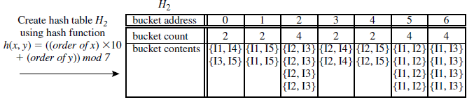
Improving the Efficiency of Apriori
Hash-based technique- when scanning for 1-itemset, generate all of the 2-itemsets for each transaction, hash them into the different buckets of a hash table structure, and increase the corresponding bucket counts

Slide 25
Improving the Efficiency of Apriori
Transaction reduction
A transaction that does not contain any frequent k-itemsets cannot contain any frequent (k+1)-itemsets.
Such a transaction can be marked or removed from further consideration because subsequent database scans for j-itemsets, where j > k, will not need to consider such a transaction.
Adv: Reducing the number of transactions scanned in future iterations

Slide 26
Partitioning
Requires just two database scans to mine the frequent itemsets.
It consists of two phases.
Phase I:
The algorithm divides the transactions of D into n nonoverlapping partitions.
If the minimum relative support threshold for transactions in D is min_sup, then the minimum support count for a partition is :
min_sup X the number of transactions in that partition
For each partition, all the local frequent itemsets (i.e., the itemsets frequent within the partition) are found.

Slide 27
A local frequent itemset may or may not be frequent with respect to the entire database, D.
However, any itemset that is potentially frequent with respect to D must occur as a frequent itemset in at least one of the partitions.
Therefore, all local frequent itemsets are candidate itemsets with respect to D.
The collection of frequent itemsets from all partitions forms the global candidate itemsets with respect to D.

Slide 28
Phase II:
A second scan of D is conducted in which the actual support of each candidate is assessed to determine the global frequent itemsets.
Partition size and the number of partitions are set so that each partition can fit into main memory and therefore be read only once in each phase.

Slide 29
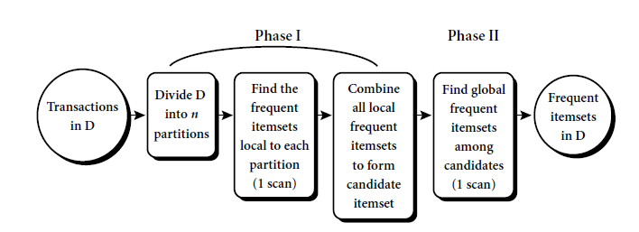
Partitioning
Requires just two database scans to mine the frequent itemsets

Slide 30
Sampling
Pick a random sample S of the given data D, and then search for frequent itemsets in S instead of D.
Result: we trade off some degree of accuracy against efficiency.
The S sample size is such that the search for frequent itemsets in S can be done in main memory, and so only one scan of the transactions in S is required overall.
We are searching for frequent itemsets in S rather than in D, it is possible that we will miss some of the global frequent itemsets.
Solution: Use a lower support threshold than minimum support to find the frequent itemsets local to S (denoted L^{S}).

Slide 31
Dynamic itemset counting
A dynamic itemset counting technique was proposed in which the database is partitioned into blocks marked by start points.
A new candidate itemsets can be added at any start point, unlike in Apriori, which determines new candidate itemsets only immediately before each complete database scan.
The technique uses the count-so-far as the lower bound of the actual count.
If the count-so-far passes the minimum support, the itemset is added into the frequent itemset collection and can be used to generate longer candidates.
This leads to fewer database scans than with Apriori for finding all the frequent itemsets.

Slide 32
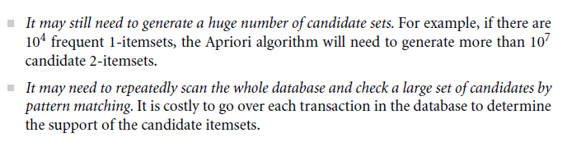
Mining Frequent Patterns Without Candidate Generation
Problems with Apriori candidate generate and test method:

Slide 33
Mining Frequent Patterns Without Candidate Generation
Frequent-pattern growth, or FP-growth
Divide-and-conquer strategy
Compresses the database representing frequent items into a frequent-pattern tree, or FP-tree which retains the iremset association information.
Divides the compressed database into a set of conditional databases, each associated with one frequent item or “pattern fragment,” and mines each such database separately.

Slide 34
